Slide 1
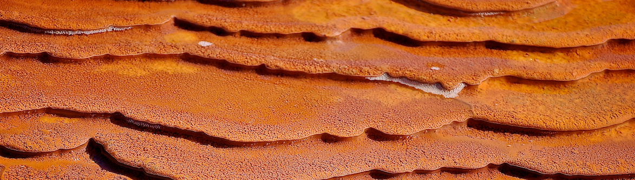
Microbial Biosignature Capture at Crystal Geyser, Utah
Jon Zaloumis
Arizona State University
School of Earth and Space Exploration
Mentor: Dr. Jack Farmer, Spring 2014

Slide 2
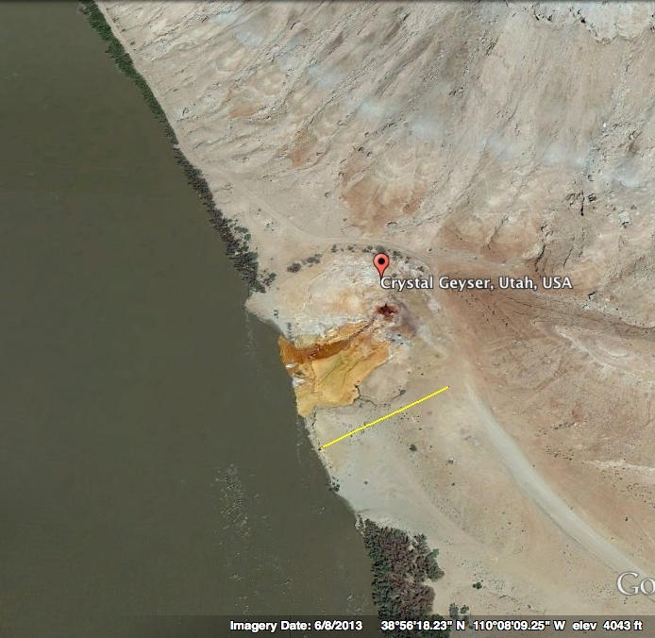
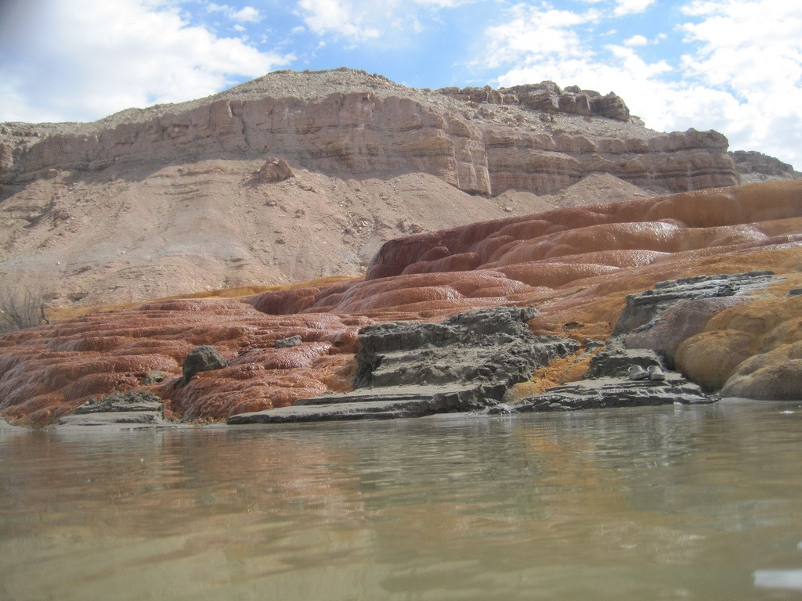
Crystal Geyser, Utah
58 m
Satellite
Ground

Slide 3
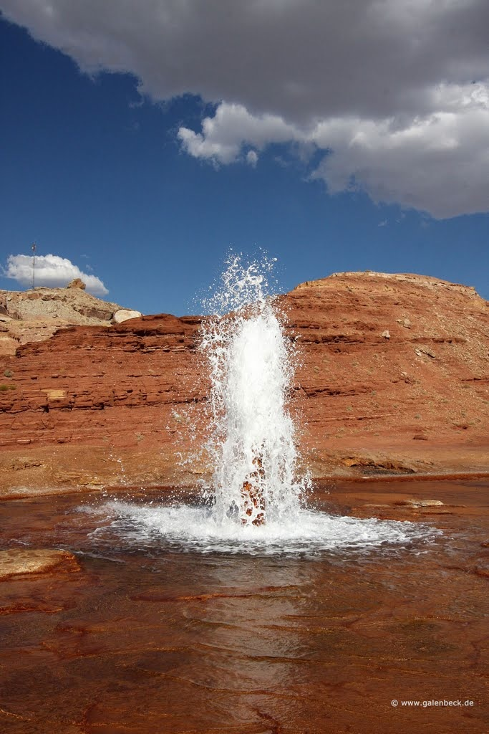
Geyser Facts
Is a cold spring, geologically distinct from typical hydrothermal springs
Fueled by super saturation of dissolved CO2
Created as a result of 1930’s oil exploration drilling at a depth of 800 m
Eruption cycles are bimodal, every 8 or 22 hours (Gouveia and Friedmann, 2006)
Eruptions last 7 - 25 minutes
Water discharge is approximately 25 m³ (Waltham, 2001)
Water contains dissolved ions (Ca²⁺, SO4²⁻, etc.) and CO2 (Waltham, 2001)

Slide 4
Precipitation of Travertine
Dissolved carbon dioxide reacts with water to form carbonate ion and hydrogen:
1. CO2 (g) + H2O (l) → CO3²⁻ (aq) + 2H⁺(aq)
Carbonate ion reacts with dissolved calcium cations to form calcium carbonate:
2. Ca²⁺ (aq) + CO3²⁻ (aq) → CaCO3 (s)

Slide 5
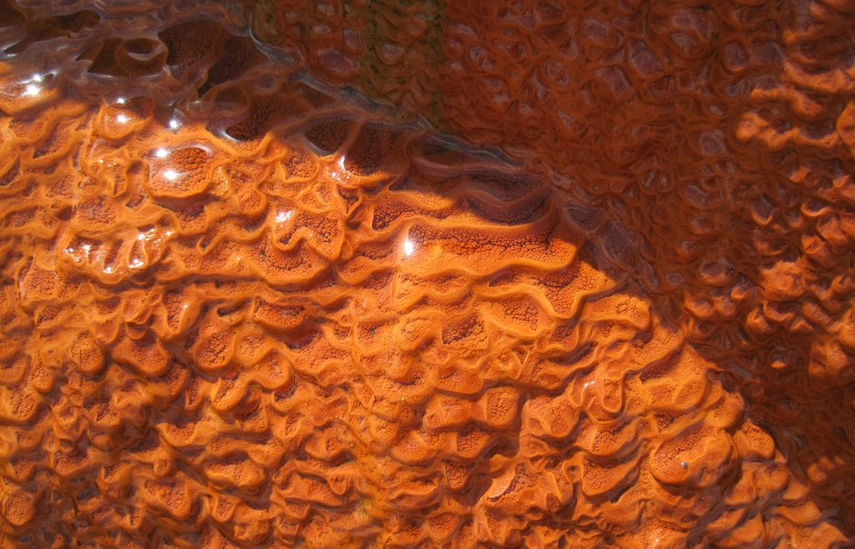
Rapid mineralization forms teracettes ~1 - 5 cm wide

Slide 6
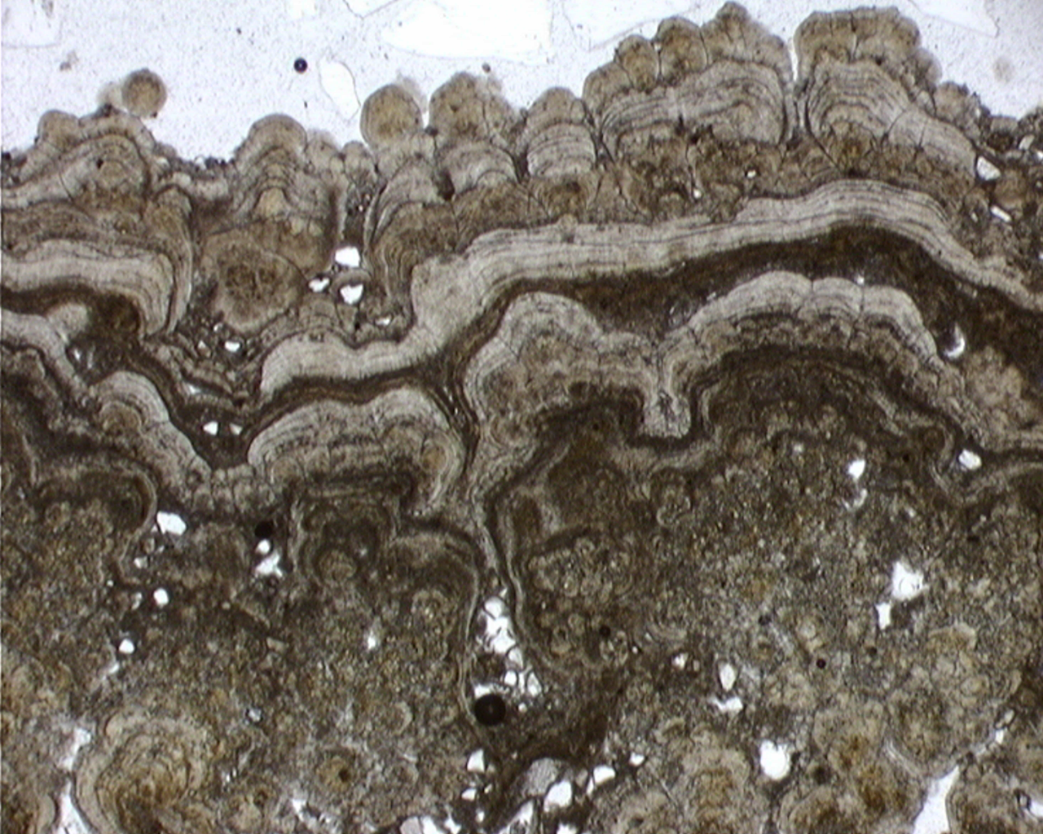
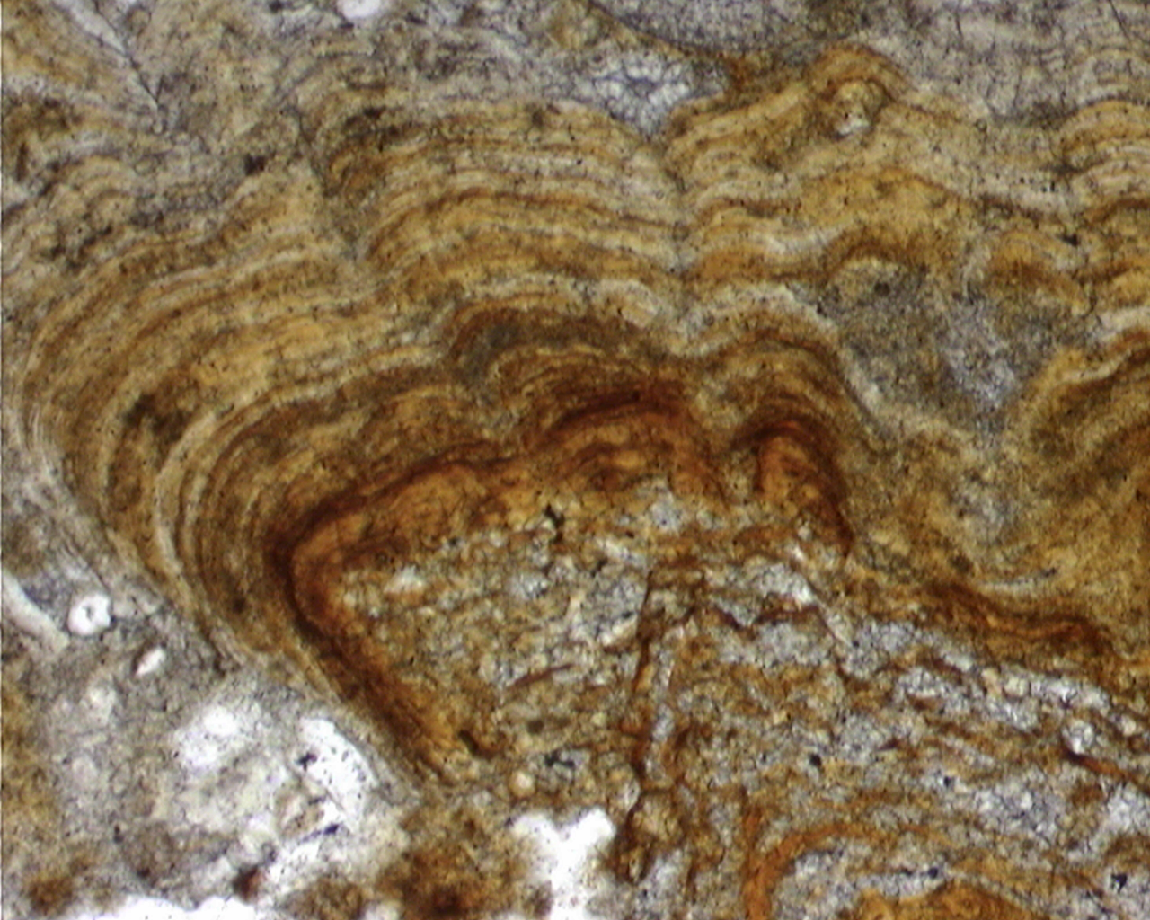
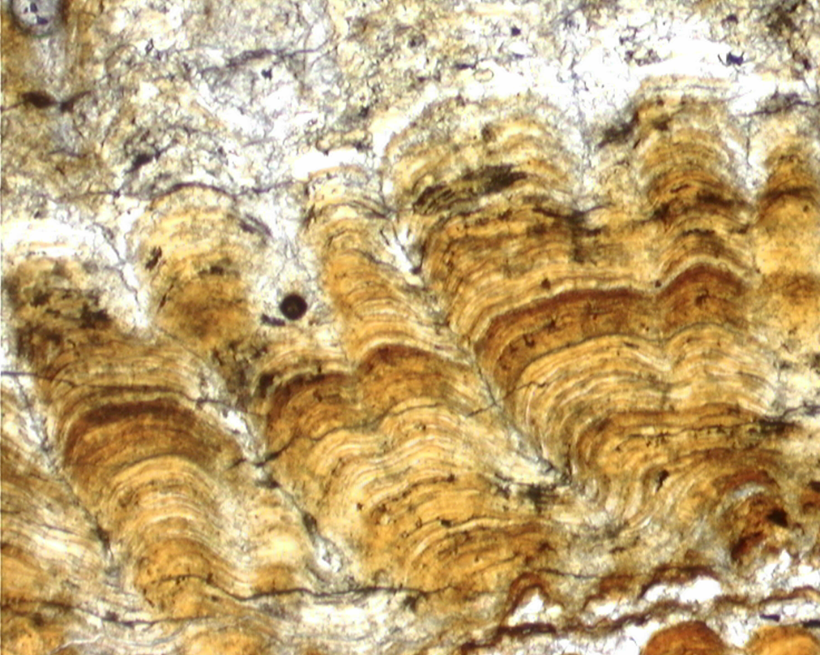
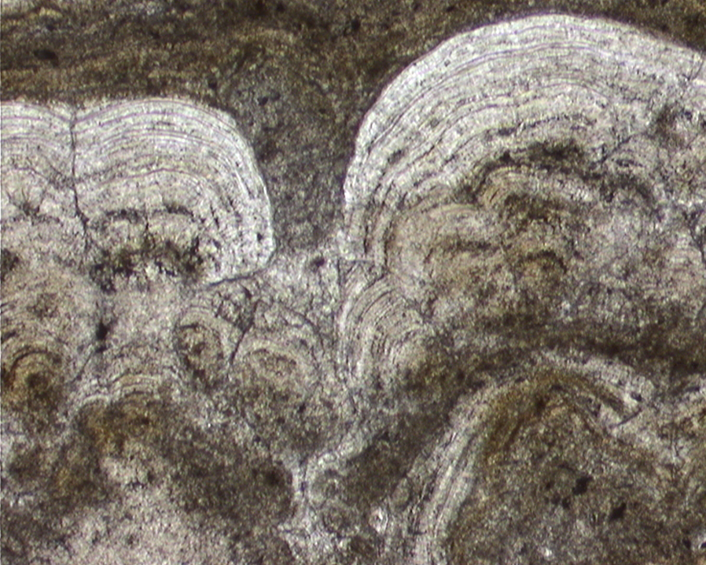
Teracette thin-sections
0.5 mm
100 µm
100 µm
100 µm

Slide 7
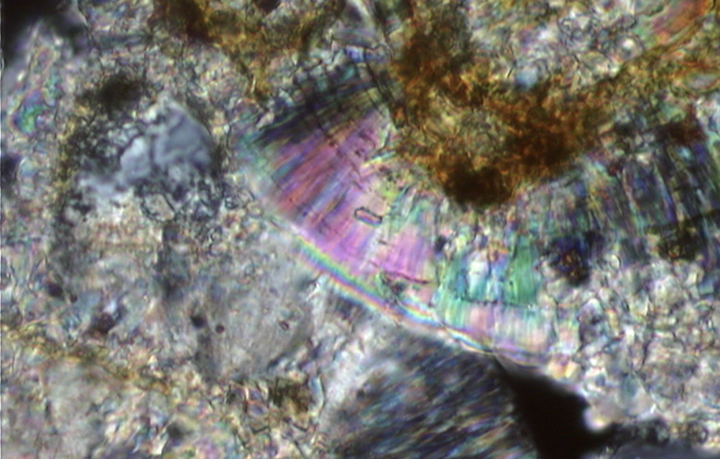
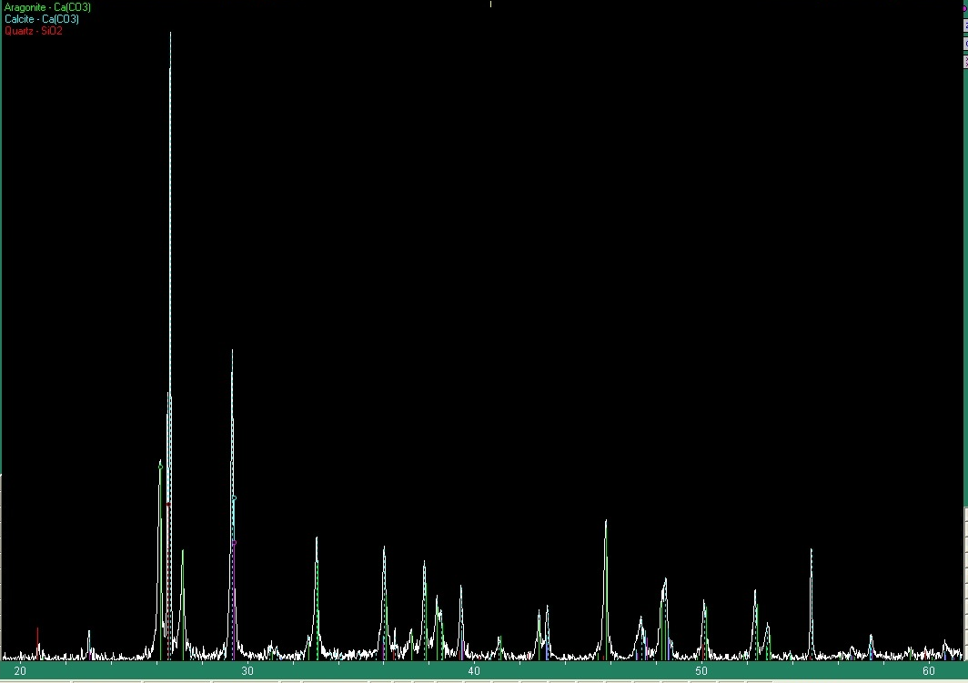
Sample Composition
Petrographic analysis confirms the bulk composition of samples to be calcium carbonate
X-Ray Powder Diffraction reveals aragonite as main carbonate constituent

Slide 8
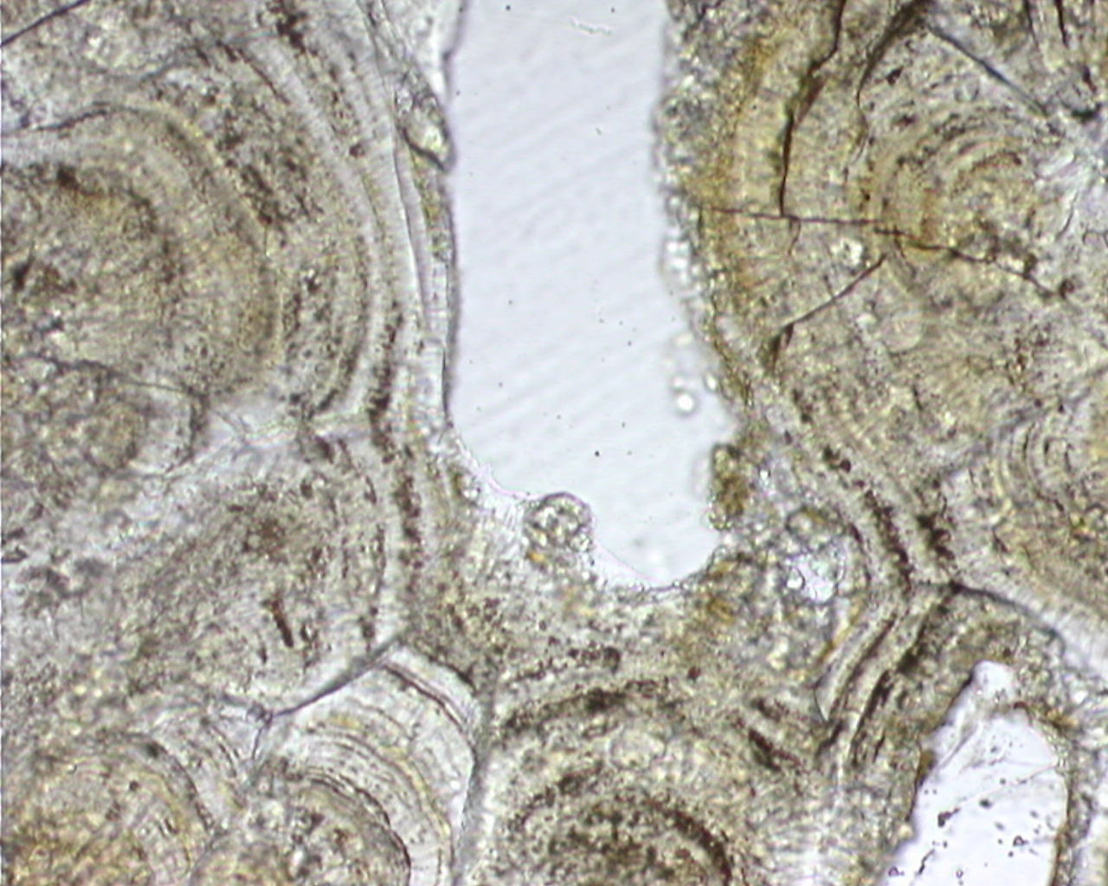
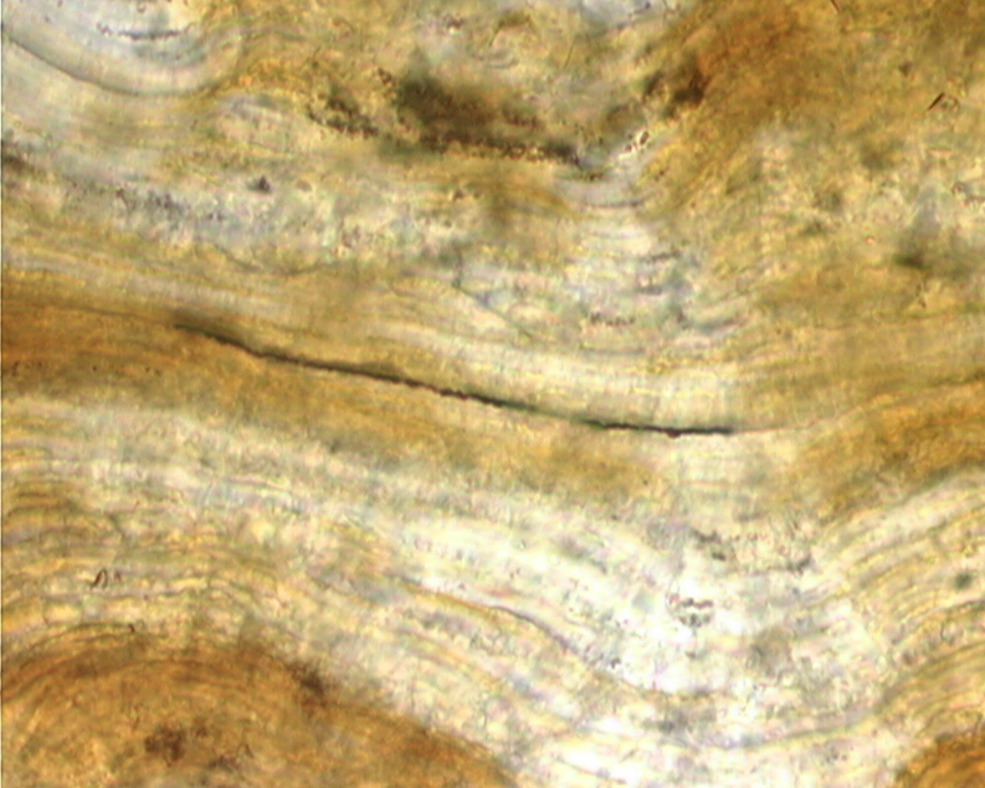
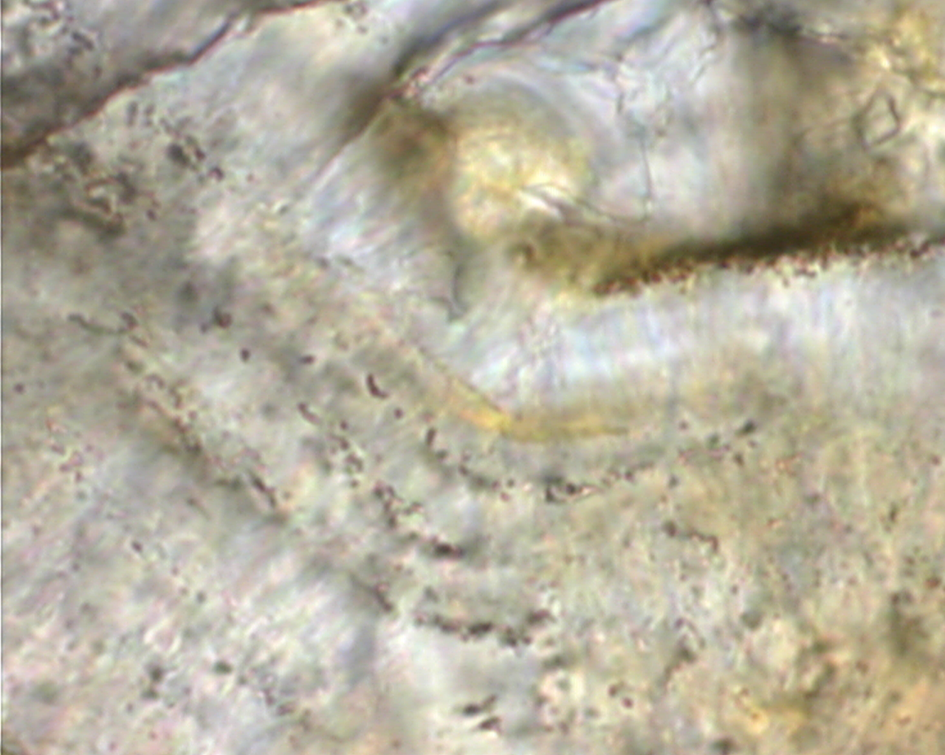
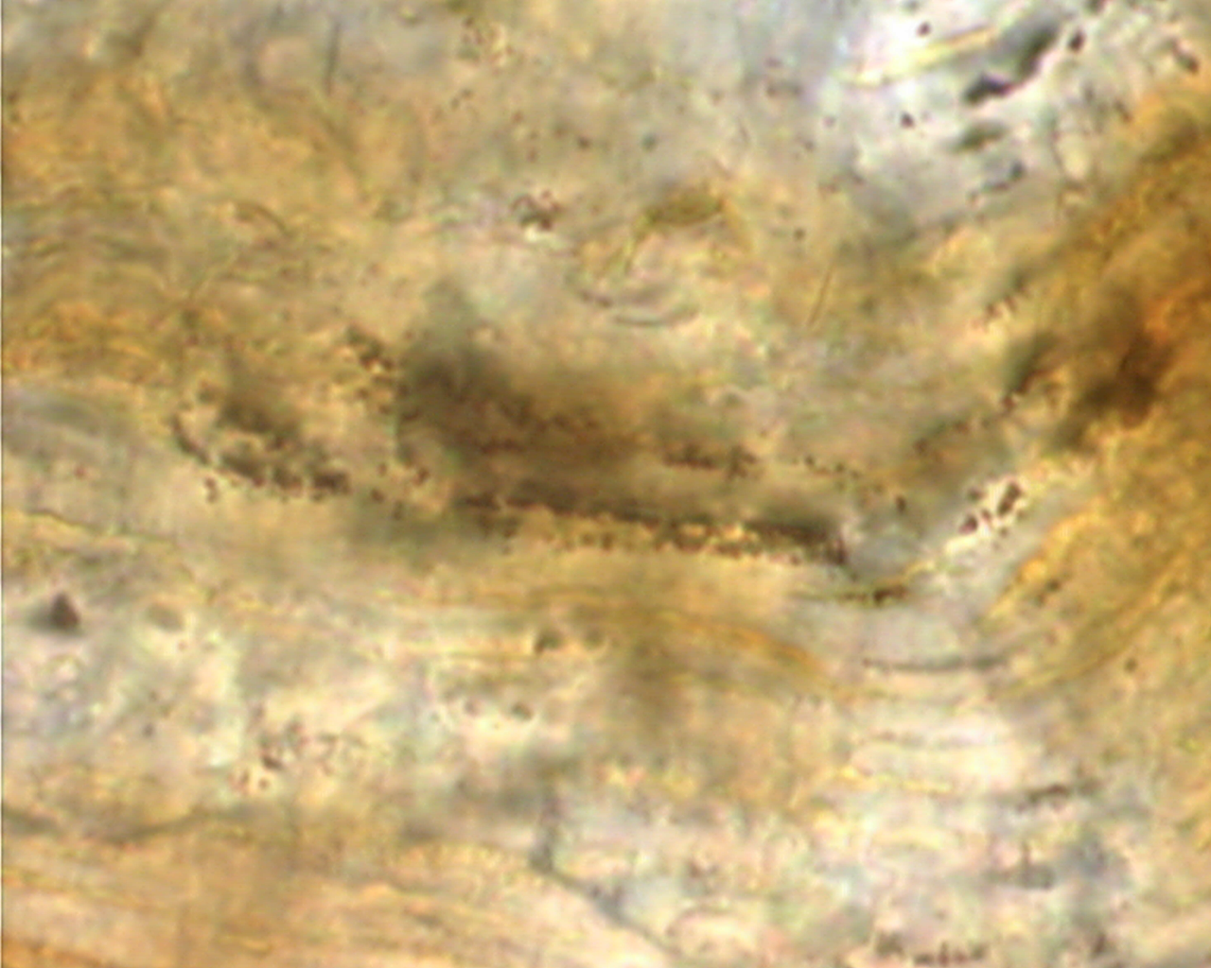
50 µm
30 µm
10 µm
10 µm

Slide 9
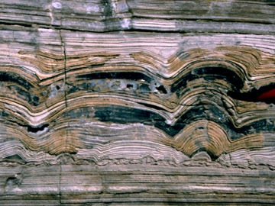
Conclusions
Aragonite is rapidly precipitating in the cold spring environment
Morphological evidence suggest biosignature capture is prevalent
Carbonate precipitation patterns resemble stromatolite formations (right) and may indicate that biology plays an important role in the precipitation process

Slide 10
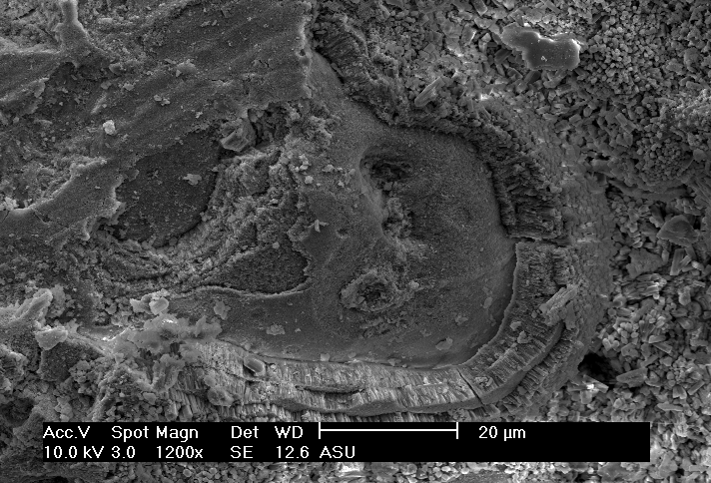
Future Work: Electron Microscopy
SEM work shows carbonate layering

Slide 11
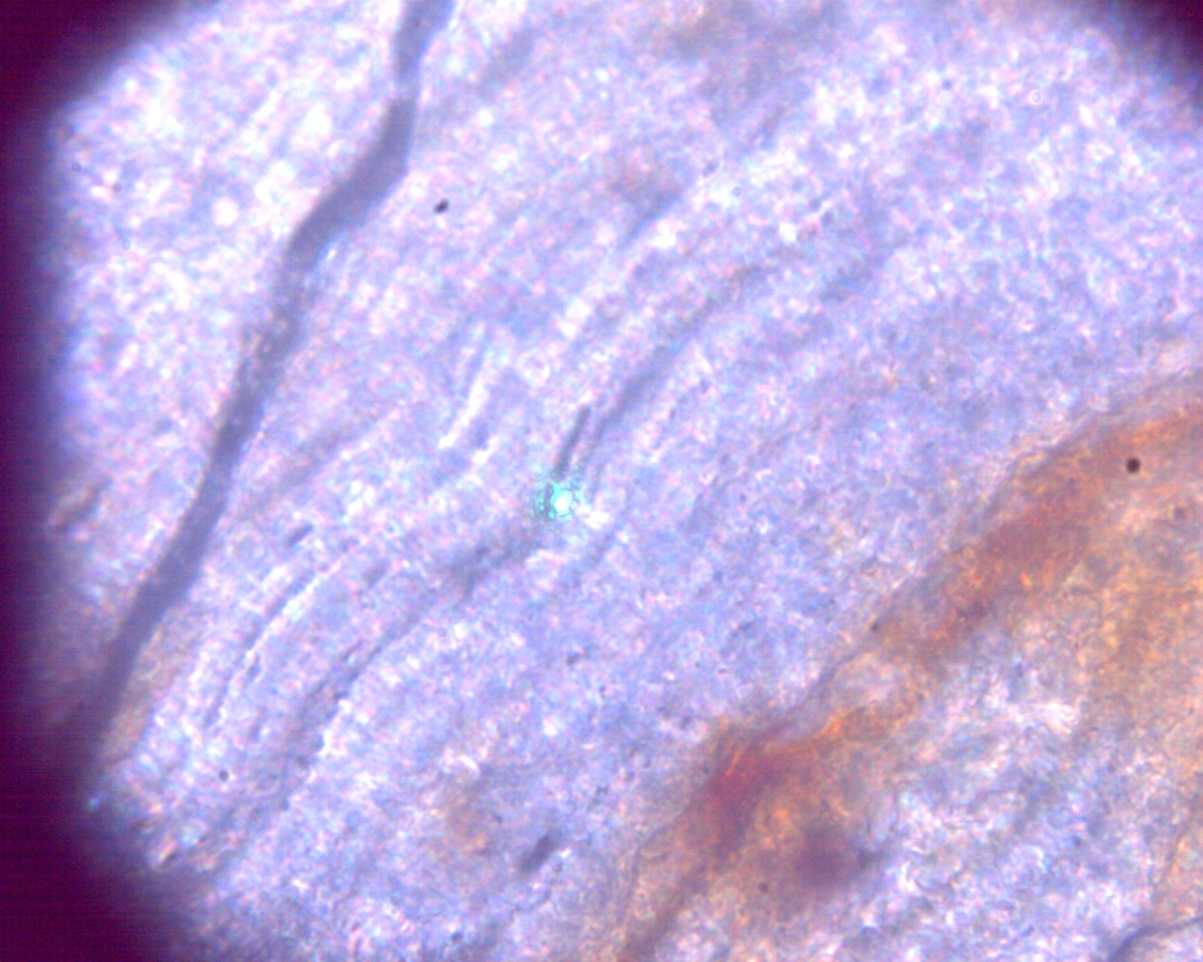
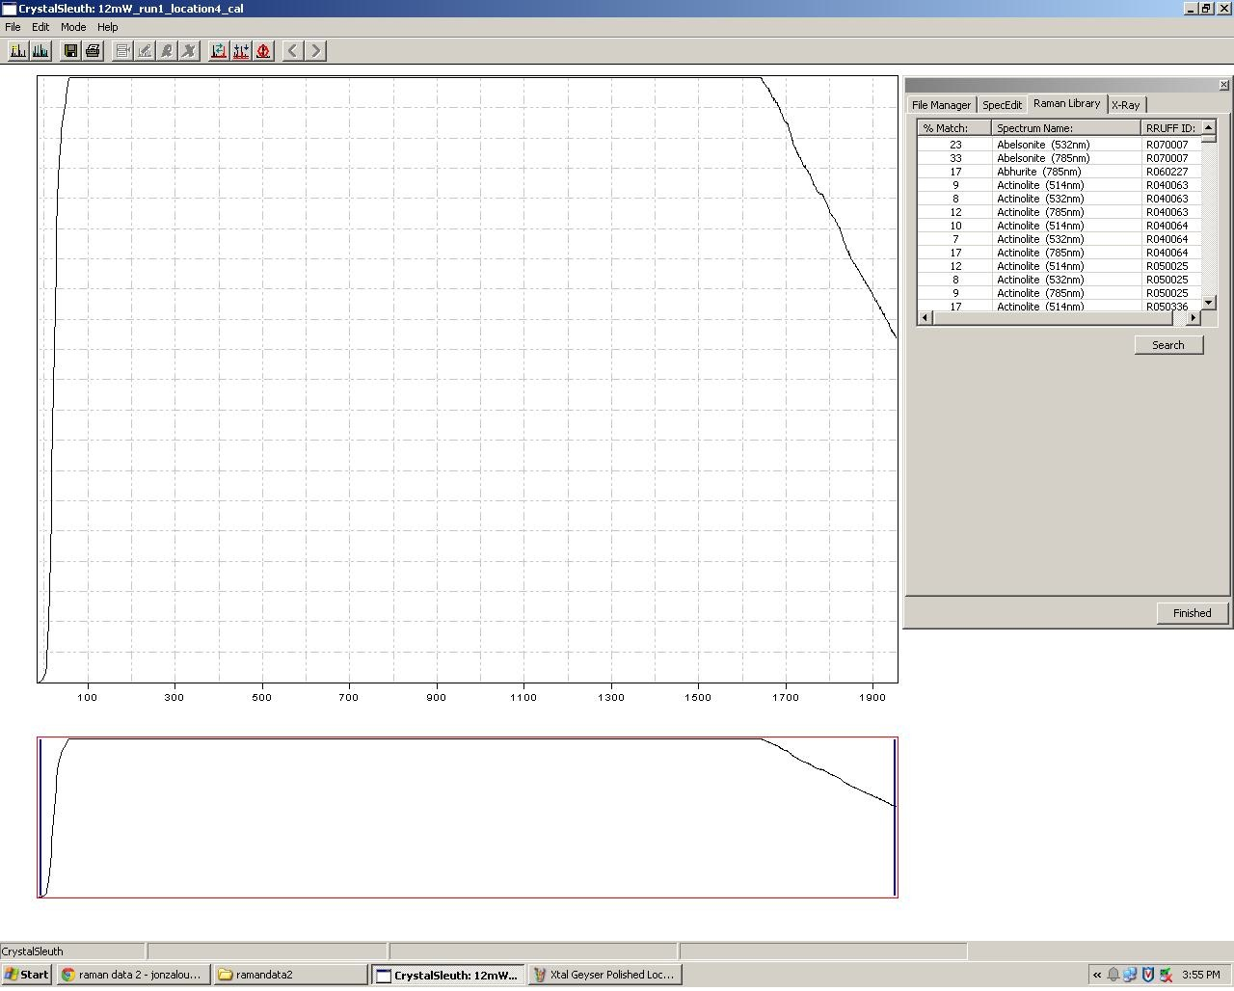
Future Work: Raman Spectroscopy
Raman laser spot on microbial layer
Fluorescence effect washes out Raman
signal, may be overcome with higher
power setting

Slide 12
References
Gouveia, F. J., and S. J. Friedmann. Timing and prediction of CO2 eruptions from Crystal Geyser, UT. United States. Department of Energy, 2006.
Waltham, Tony. "Crystal Geyser–Utah's cold one." Geology Today 17.1 (2001): 22-24.
Image credits: Flickr user juniperus_scopulorum, Google Earth, www.galenbeck.de

